Slide 1
Understanding XML and DOM with Java
An Introduction to XML and Document Object Model (DOM) using Java

Slide 2
Overview of the topics to be covered
eXtensible Markup Language (XML)
Introduction to XML
Document Object Model (DOM) using JAXP

Slide 3
eXtensible Markup Language (XML)
XML is a simple text-based language which was designed to store and transport data in plain text format.
It stands for Extensible Markup Language.
XML is a markup language.
XML is a tag based language like HTML.
XML tags are not predefined like HTML.
You can define your own tags which is why it is called extensible language.
XML tags are designed to be self-descriptive.
XML is W3C Recommendation for data storage and data transfer.

Slide 4
Human-readable:
XML documents are designed to be easily readable and understandable by both humans and machines.
They use a hierarchical structure with tags and attributes that resemble natural language, enhancing readability.
<book>
<title>Harry Potter and the Philosopher's Stone</title>
<author>J.K. Rowling</author>
<genre>Fantasy</genre>
<year>1997</year>
</book>

Slide 5
Self-descriptive:
XML documents contain metadata and structure information within the document itself.
They use tags to define the meaning and purpose of data elements, making them self-descriptive.
XML Schema Definition (XSD) or Document Type Definition (DTD) can further specify the structure and data types, enhancing self-description.

Slide 6
<!-- This is a comment -->
<employee id="101">
<name>John Doe</name>
<department>IT</department>
<salary>50000</salary>
</employee>

Slide 7
Platform-independent:
XML is not tied to any specific operating system or programming language.
XML documents can be created, processed, and exchanged across different platforms and environments.
This platform independence facilitates interoperability and data exchange between heterogeneous systems.

Slide 8
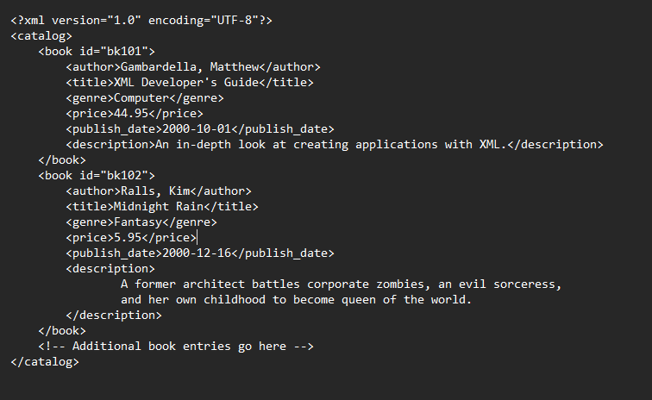
Example of an XML document structure

Slide 9
History of XML
XML, or eXtensible Markup Language, traces its origins back to the late 1990s when it emerged as a successor to both SGML (Standard Generalized Markup Language) and HTML (Hypertext Markup Language).
XML 1.0 was officially published by the World Wide Web Consortium (W3C) in February 1998.
The design goals of XML included simplicity, generality, and usability across different platforms and applications.
Key contributors to the development of XML include Tim Bray, Jean Paoli, and Michael Sperberg-McQueen.

Slide 10
Adoption and Standardization:
XML quickly gained widespread adoption across various industries and domains.
It became the de facto standard for data exchange, configuration files, and document representation.
XML-related technologies, such as XSLT (eXtensible Stylesheet Language Transformations) and XPath, further expanded its capabilities.

Slide 11
Evolution:
Over the years, XML has undergone several revisions and enhancements to address emerging requirements and challenges.
XML namespaces were introduced to enable the mixing of different XML vocabularies within a single document.
XML Schema Definition (XSD) and Document Type Definition (DTD) provided mechanisms for defining the structure and constraints of XML documents.

Slide 12
Current Status:
XML continues to be widely used in various applications and industries, although its popularity has somewhat declined with the rise of alternative data formats such as JSON (JavaScript Object Notation).
However, XML remains relevant in specific use cases where its features, such as self-descriptiveness and validation capabilities, are advantageous.

Slide 13
Importance of XML in data exchange and storage
Universal Data Format:
Flexibility and Extensibility:
Human-Readable Format:
Self-Descriptive Nature:
Validation and Integrity:
Platform-Independent Representation:
Document Management:

Slide 14
Use cases of XML in various industries:
Web Development:
  XML is extensively used in web development for structuring and exchanging data between web servers and clients.
  It is commonly employed in web services to enable communication between different applications over the internet.
  XML-based technologies like SOAP (Simple Object Access Protocol) and RESTful APIs utilize XML for message exchange, allowing seamless integration and interoperability between distributed systems.
  XHTML (Extensible Hypertext Markup Language) is an XML-based markup language used for creating web pages with stricter syntax rules compared to HTML, ensuring compatibility with XML tools and parsers.

Slide 15
Data Interchange:
  XML serves as a standard format for data interchange between different systems, platforms, and organizations.
  It is widely adopted in industries such as finance, healthcare, logistics, and manufacturing for exchanging structured data between disparate systems and stakeholders.
  XML's self-descriptive nature and support for validation ensure data integrity and consistency during the exchange process.
  Industries like e-commerce rely on XML for transmitting product information, orders, invoices, and other business documents between trading partners and systems.

Slide 16
Configuration Files:
  XML is commonly used for storing configuration settings and parameters in software applications and systems.
  Configuration files written in XML format provide a structured and human-readable way to define application settings, preferences, and customization options.
  XML's hierarchical structure allows for organizing configuration data into sections, properties, and values, making it easy to manage and maintain.
  Many software frameworks and libraries support XML configuration files, enabling developers to configure application behavior without modifying source code.

Slide 17
Thank you!!

